Slide 1

David and Psalms

Slide 2
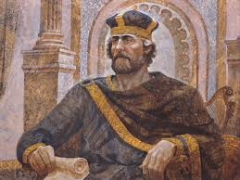
David’s Life
Date | Age | Event | Bible
1040 B.C |  | David born | 2 Sam 5:4
 | 15-17 | David and Goliath
1012 B.C | 17-30 | David is a fugitive from Saul
1010 | 30 | David becomes a king in Hebron | 2 Sam 5:4-5
1007 | 37 | David becomes a king over all Israel | 2 Sam 5:4-5
 | 47 | David sins with Bathsheba
 | 47-52 | Absalom kills Amnon and flees to Geshur | 2 Sam 13:38
 | 62 | Absalom killed
 | 62-63 | Sheba’s rebellion
 | 65-67 | David becomes exhausted in Philistine battle | 2 Sam 21:15
970 B.C | 70 | David dies | 2 Sam 5:4-5

Slide 3
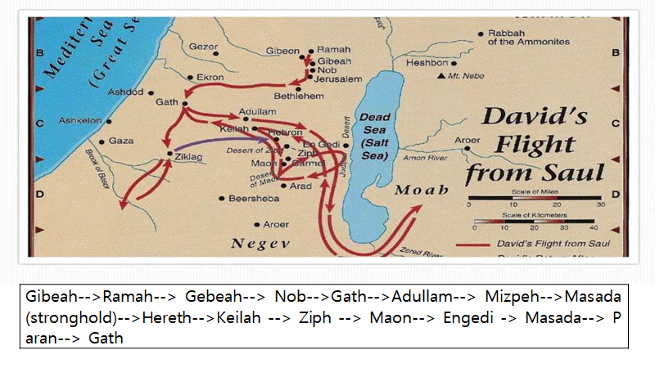
David’s Flight from Saul

Slide 4
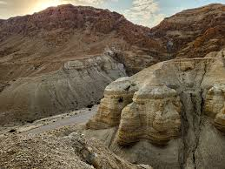
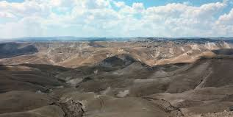
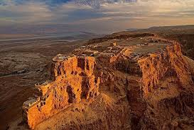
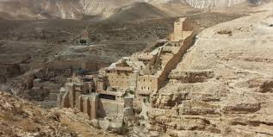
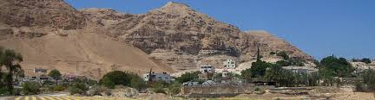
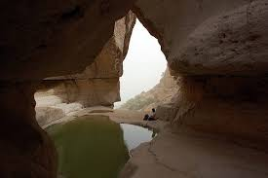
Judean Desert

Slide 5
David and Psalms
No | Psalm | Contents | Bible
1 | 59 | Saul sends men to kill him | 1 Sam 19:11-18
2 | 56 | The Philistines seize David in Gath | 1 Sam 21:10-12
3 | 34 | David delivered from king Achish of Gath | 1 Sam 21:13-15
4 | 142 | David flees from Saul into a cave | 1 Sam 22:1-2
5 | 52 | Doeg the Edomites tell Saul that David went to the priests | 1 Sam 22:7-18
6 | 63 | David in the Judean Desert | 1 Sam 22:5
7 | 54 | The Ziphites tell Saul that David is hiding | 1 Sam 23:19-29
8 | 57 | David flees from Saul into a cave | 1 Sam 24
9 | 60 | David’s victory over Transjordan | 2 Sam 8
10 | 51 | David repents when Nathan comes to him | 2 Sam 12:7, 9-14
11 | 3 | David flees from Absalom | 32 Sam 15:13-23
12 | 7 | The Words of Cush, a Benjaminites | 2 Sam 16
13 | 18 | David delievered from Saul | 2 Sam 22
14 | 30 | David’s dedication of the Temple | 2 Sam 5:4-12
15 | 23 | David’s praise the Lord as a shepherd

Slide 6
Psalm 52
For the director of music. A maskil of David. When Doeg the Edomite had gone to Saul and told him: “David has gone to the house of Ahimelek.”
1 Why do you boast of evil, you mighty hero? Why do you boast all day long, you who are a disgrace in the eyes of God?
2 You who practice deceit, your tongue plots destruction; it is like a sharpened razor.
3 You love evil rather than good, falsehood rather than speaking the truth.
4 You love every harmful word, you deceitful tongue!
5 Surely God will bring you down to everlasting ruin: He will snatch you up and pluck you from your tent; he will uproot you from the land of the living.
6 The righteous will see and fear; they will laugh at you, saying,
7 “Here now is the man who did not make God his stronghold but trusted in his great wealth and grew strong by destroying others!”
8 But I am like an olive tree flourishing in the house of God; I trust in God’s unfailing love for ever and ever.
9 For what you have done I will always praise you in the presence of your faithful people. And I will hope in your name, for your name is good.

Slide 7
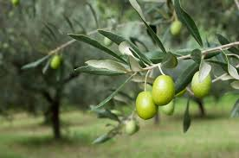
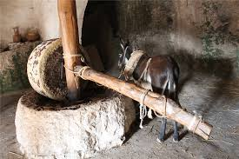
52:8, But I am like an olive tree flourishing in the house of God; I trust in God’s unfailing love for ever and ever.
1:3, That person is like a tree planted by streams of water, which yields its fruit in season and whose leaf does not wither whatever they do prospers.

Slide 8
Psalm 34
Of David. When he pretended to be insane before Abimelek, who drove him away, and he left.
1 I will extol the LORD at all times; his praise will always be on my lips.
2 I will glory in the LORD; let the afflicted hear and rejoice.
3 Glorify the LORD with me; let us exalt his name together.
4 I sought the LORD, and he answered me; he delivered me from all my fears.
5 Those who look to him are radiant; their faces are never covered with shame.
6 This poor man called, and the LORD heard him; he saved him out of all his troubles.
7 The angel of the LORD encamps around those who fear him, and he delivers them.
8 Taste and see that the LORD is good; blessed is the one who takes refuge in him.
9 Fear the LORD, you his holy people, for those who fear him lack nothing.
10 The lions may grow weak and hungry, but those who seek the LORD lack no good thing.

Slide 9
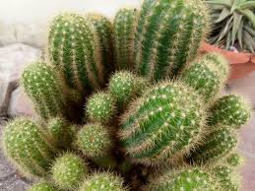
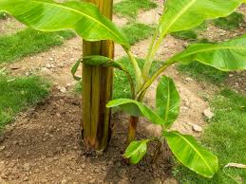
What have I learned from this?

Slide 10
Psalm 63
Thirsty
Ps 63:1, You, God, are my God, earnestly I seek you; I thirst for you, my whole being longs for you, in a dry and parched land where there is no water.
Jer 14:6, “The deer of the field give birth, but they abandon it, for there is no grass; the wild donkeys stand on the high hills, panting like wild dogs; their eyes fail because there is no grass.”
Amos 4:8, “Two or three cities have wandered to a city to drink water, but they have not been satisfied; yet you have not returned to me, declares the LORD.”
Ps 143:6, “I spread out my hands to you; my soul thirsts for you like a dry land (Selah)” (Psalm 143:6).
2) Lack of God’s Presence
Ps 63:2, To see Thy power and Thy glory, so as I have seen
Ps 42:1-2, Like a thirsty deer, I long for the Lord. “Where is your God?” This question hurts the most. Because of it, I am discouraged and anxious.

Slide 11
3) Finding a way to get closer to God
Ps 63:6, When I remember Thee upon my bed, and meditate on Thee in the night watches.
PRESS SPEAK
. P . S
. R . P
. E . E
. S . A
. S . K

Slide 12
Psalm 57
For the director of music. To the tune of “Do Not Destroy.” Of David. A miktam.^{[b]} When he had fled from Saul into the cave.
¹ Have mercy on me, my God, have mercy on me,
for in you I take refuge.
I will take refuge in the shadow of your wings
until the disaster has passed.
² I cry out to God Most High,
to God, who vindicates me.
³ He sends from heaven and saves me,
rebuking those who hotly pursue me—^{[c]}
God sends forth his love and his faithfulness.
⁴ I am in the midst of lions;
I am forced to dwell among ravenous beasts—
men whose teeth are spears and arrows,
whose tongues are sharp swords.
⁵ Be exalted, O God, above the heavens;
let your glory be over all the earth.
⁶ They spread a net for my feet—
I was bowed down in distress.
⁷ My heart, O God, is steadfast,
my heart is steadfast;
I will sing and make music.
⁸ Awake, my soul!
Awake, harp and lyre!
I will awaken the dawn.
⁹ I will praise you, Lord, among the nations;
I will sing of you among the peoples.
¹⁰ For great is your love, reaching to the heavens;
your faithfulness reaches to the skies.
¹¹ Be exalted, O God, above the heavens;
let your glory be over all the earth.

Slide 13
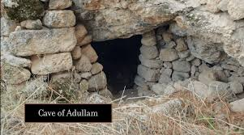
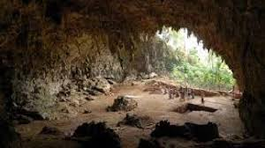
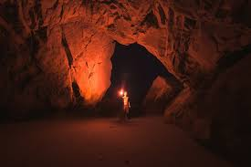
Adullam (1 Sam 22:1-2)

Slide 14

Psalms 57:5
Be exalted, O God, above the heavens; let your glory be over all the earth

Slide 15
Psalm 30
1) Gratitude for salvation
30:1, I will extol Thee, O Lord; for Thou hast lifted me up, and hast not made my foes to rejoice over me.
30:3 O Lord, Thou hast brought up my soul from the grave: Thou hast kept me alive, that I should not go down to the pit. Do we have this sense of salvation when we worship?
2) Gratitude for Healing
30:2,5, O Lord my God, I cried unto Thee, and Thou hast healed me.
30:5, For His anger lasts but a moment; in His favor is life: weeping may endure for a night, but joy cometh in the morning. When we suffer, we think that we are being disciplined and beaten by God.
Heb. 12:5-13. Do not be discouraged when you are disciplined. Even earthly fathers discipline their children. It is not punishment for the sake of punishment. 12:10, it is to benefit from discipline.
3) Petition for continued grace
30:10, Hear, O Lord, and have mercy upon me: Lord, be Thou my helper.
4) Pledge of devotion
30:11-12, Thou hast turned for me my mourning into dancing: Thou hast put off my sackcloth, and girded me with gladness. To the end that my glory may sing praise to Thee, and not be silent. O Lord my God, I will give thanks unto Thee forever.

Slide 16
Isaiah 6:1-8
Let’s look at the worship shown in Isaiah 6:1-8.
Holy Expectancy (Come) | Holy Presence (Presence) | Holy Obedience (Go)
Preparation of prayer and aspiration from heart in gathering as a body | Encounter with God by listening the word and praising and offering in the Holy Spirit | Being sent to the world to serve(preach, teach and heal)
Isaiah 6:1 | Isaiah 6:1-7 | Isaiah 6:8
. Preparation to Worship . Bow down | . Praise . Listening the word . Offering . Forgiveness | Sending to the World

Slide 17
Ministries of the Shepherd
Psalm 23:1-6
Provider | Leader | Protector | Nurturer | Worshipper
23:2 | 23:3 | 23:4 | 23:5 | 23:6
Lie down in green pasture, water | John 10:10, He goes on ahead of them | Staff and Rod | In the presence of enemy, overflows | In the house of the Lord

Slide 18
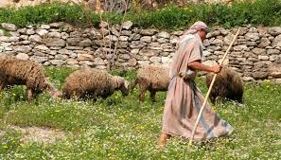
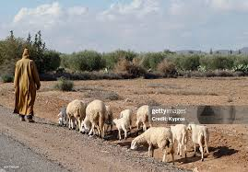
Philip Keller, Psalm 23 in the light of the shepherd and the sheep)
How do you get water in the wilderness?
Philip Keller, Psalm 23 in the light of the Shepherd and Sheep
How can get the water in the wilderness?
Fear | emotional
Conflict | relational
Insect | spiritual
Hunger | existential
Dew | Dew at dawn everyday. Around 500 mm a year
Rain | Rain from heaven in rainy season regularly. from November to February
Cistern | Well dug from the earth
Spring | Natural spring welling up all the time like Engedi

Slide 19
Summary and Application
Summary | David’s Life David’s flight from Saul David’s Psalm
Application | Ps 52 Ps 34 Ps 63 Ps 30 Ps 23
Reflection

